Slide 1
【WebSphere Developer for zSeries】
Project Development and Debug

Slide 2
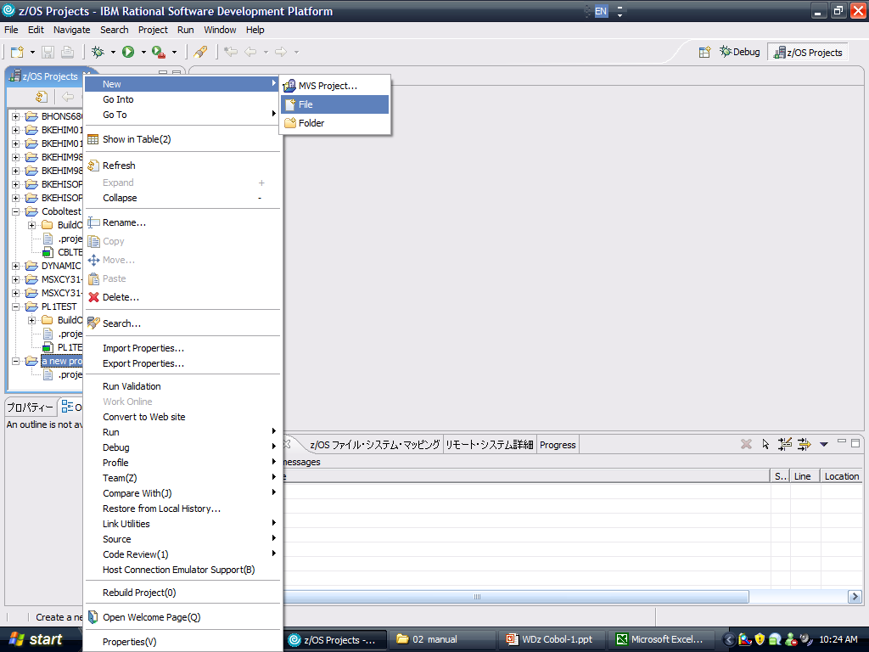
1. Create Cobol or PL/I programs
Create .cbl for Cobol and .pli for PL/I
Multiple Cobol programs can be in the same project,
while PL/I programs must be in different projects.

Slide 3
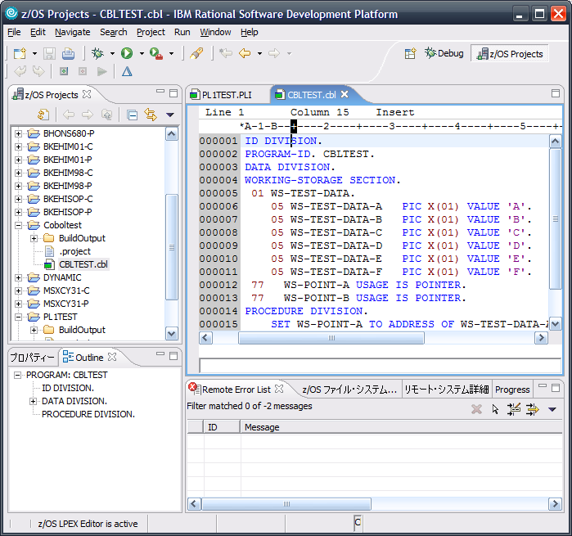
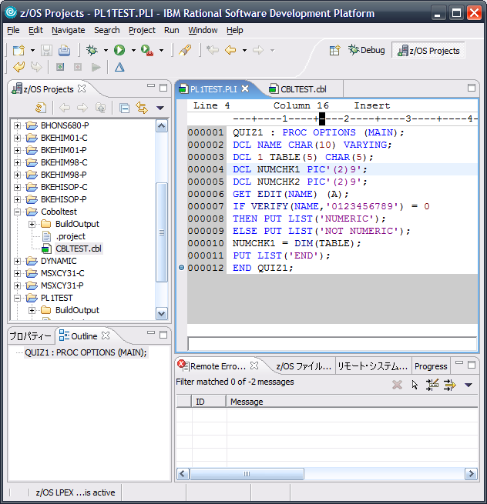
2. Coding Cobol or PL/I program source
The process of coding source is the same as on mainframe

Slide 4
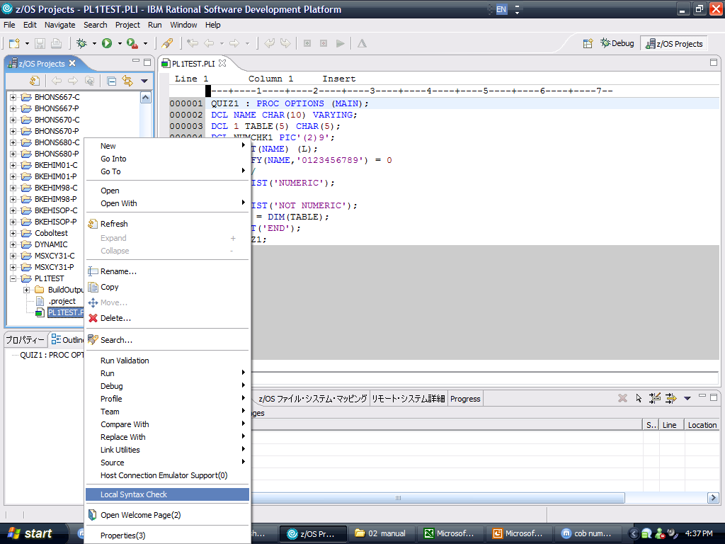
3. Local Syntax Check
If error exists, error message will be shown in ‘Remote Error List’

Slide 5
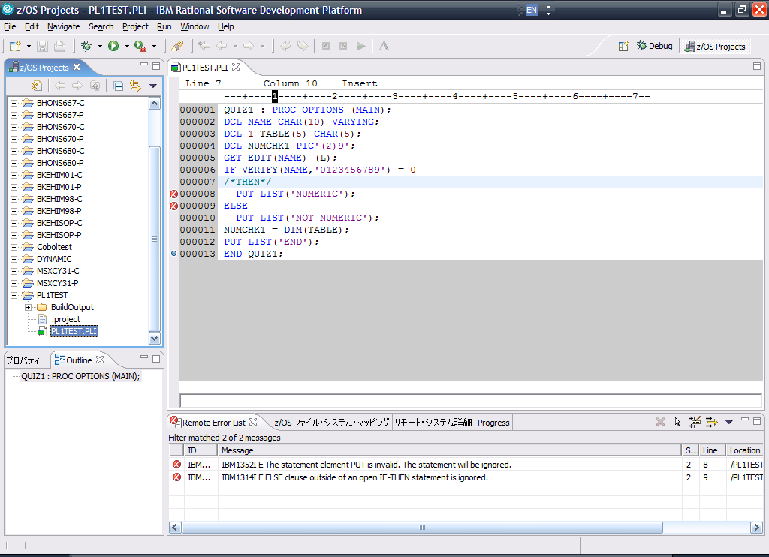
3. Local Syntax Check (sample)
In this sample, THEN statement was lost
Lines with error will be marked out
Detailed error descriptions will be shown in ‘Remote Error List’

Slide 6
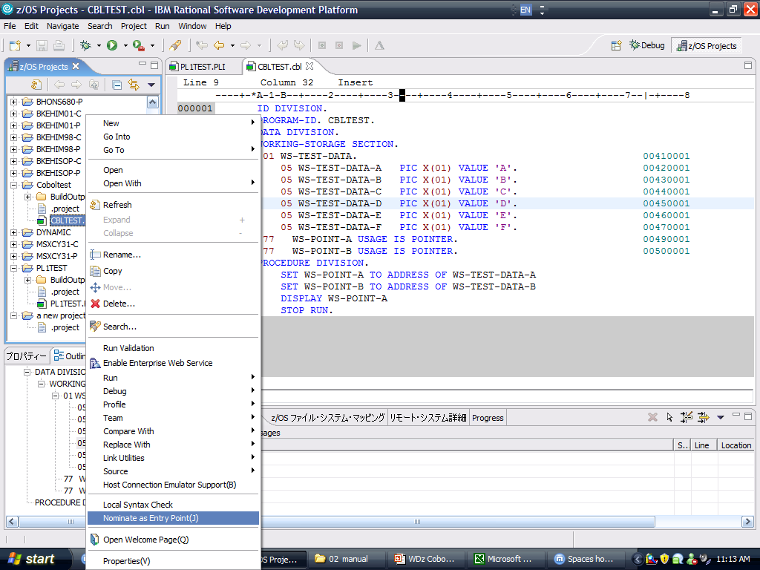
4. Specify the program to be compiled
For Cobol project, program to be compiled must be nominated as Entry Point,
while for PL/I project, this step is unnecessary.

Slide 7
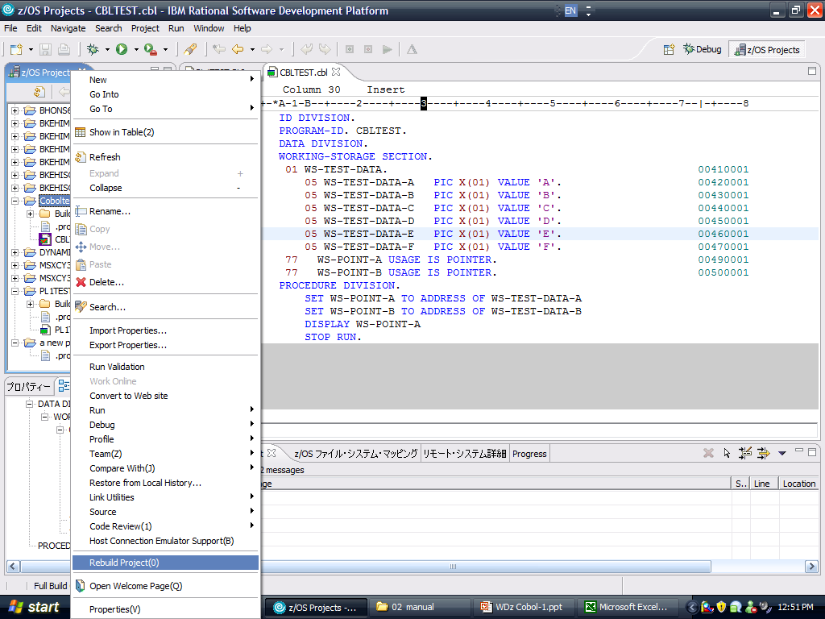
5. Compile the program

Slide 8
5. Compile the program
In Cobol project, only program nominated as Entry Point will generate the build module.
In compile procedure, if no error occurs, the program’s build module will be generated in the BuildOutput folder of the project.
The name of the build module will be the same as the name of the program.
Suffix name will be .EXE or .DLL due to ‘Local Link Options’

Slide 9
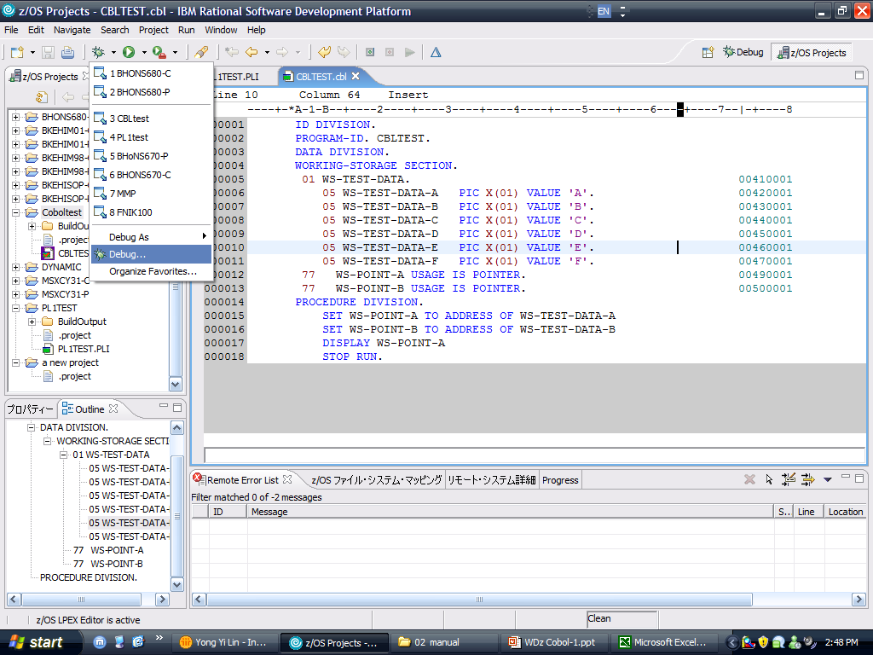
6. Program debug

Slide 10
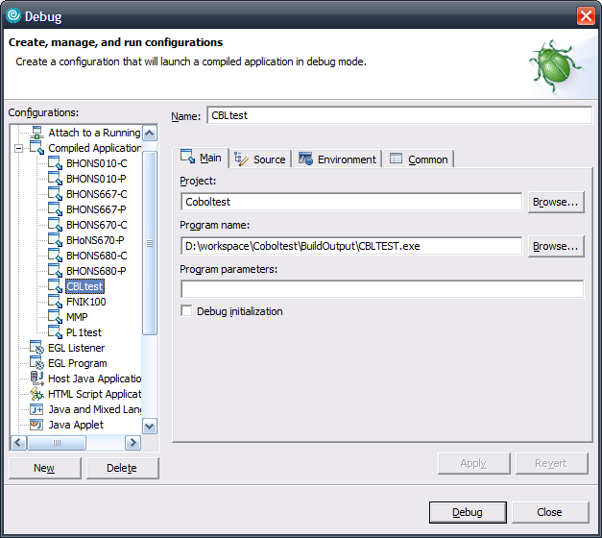
7. Debug Configuration
A name of the debug configuration
The project in which your program is
The location where your compiled program is
Create a new debug configuration

Slide 11
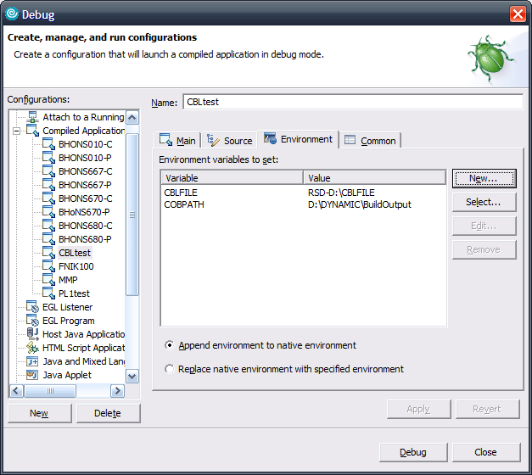
8. Debug Configuration for Cobol
Name is same as the name of the ASSIGN TO statement in Cobol program.
Value is the location of the local file, started with ‘RSD-’.
COBPATH is a special variable which related with the dynamic call modules.
Value is the location of the dynamic call build module’s location.
After Main and Environment parameters were set, click Debug

Slide 12
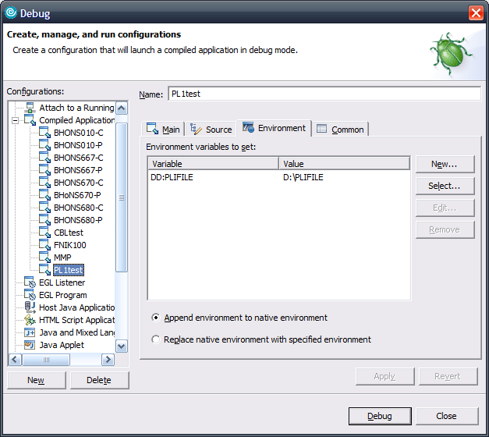
8. Debug Configuration for PL/I
Name is the same as the DCL specified name in PL/I program, started with ‘DD:’
Value is the location of the local file
After Main and Environment parameters were set, click Debug

Slide 13
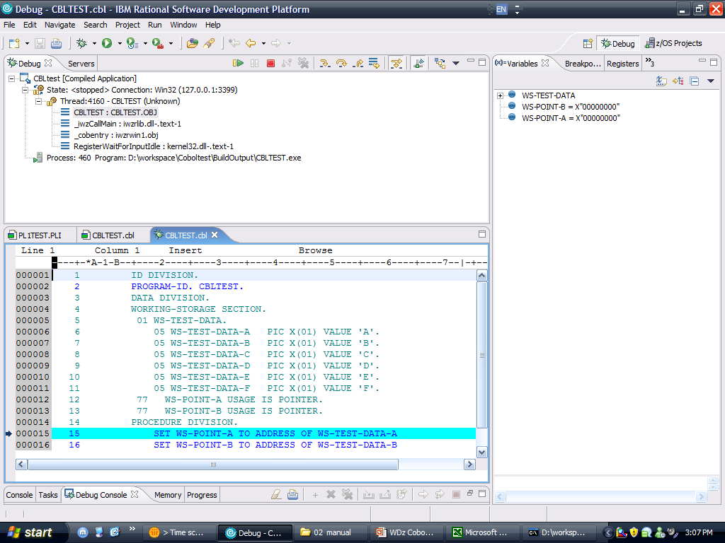
9. Debug layout
Stop debug
Debug step by step
During debug, all variables will be listed with the value
Auto processing until meets breakpoint or program end
For Cobol: when processing CALL subroutine statement, get into the subroutine.
For PL/I: when processing CALL PROC statement, get into the proc.
Double click to add breakpoint

